Slide 1

Meta Ad Performance Analysis - RetailNova
Driving strategic decisions through comprehensive Facebook and Instagram campaign insights

Slide 2
Business Objective & Approach
Business Objective
RetailNova is a global e-commerce brand specializing in lifestyle and fashion products.
The business needs a performance tracking report for advertising campaigns running on Facebook and Instagram.
The report will provide visibility into campaign reach, engagement, conversions, and budget utilization. This will enable the marketing team to:
• Identify the most effective platform (Facebook vs Instagram).
• Track campaign ROI and optimize budget allocation.
• Understand audience engagement patterns.

Slide 3

Facebook Performance Overview
216K
25.4K
11.76%
Impressions
Clicks
CTR
Strong reach across target audiences
Exceptional engagement levels
5× above industry standard
1.3K
Purchases
Direct revenue generation
Platform Strengths
Key Opportunity
Facebook delivers superior volume and conversion efficiency with a 5.21% conversion rate from clicks. The platform excels at driving both awareness and purchase actions, making it ideal for performance-focused campaigns targeting immediate ROI.
Despite strong top-funnel performance, only 0.61% of impressions convert to purchases. This indicates significant potential for landing page optimization and retargeting strategies.

Slide 4

Instagram Performance Overview
123.8K
14.7K
11.86%
Impressions
Clicks
CTR
Focused visual engagement
Strong interest signals
Matching Facebook performance
708
Purchases
Quality conversions
Brand Impact
Conversion Insight
Instagram excels in visual storytelling with a 13.60% engagement rate. The platform drives strong brand awareness and consideration among aesthetically-focused audiences.
With a 4.82% conversion rate and 0.57% purchase rate, Instagram performs slightly below Facebook in direct conversions. This suggests the platform is better suited for top-funnel awareness and mid-funnel engagement, requiring stronger retargeting to capture purchase intent.

Slide 5
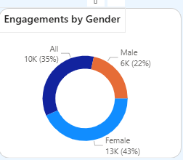
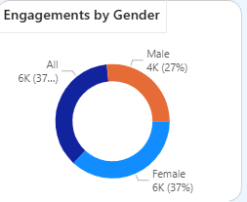
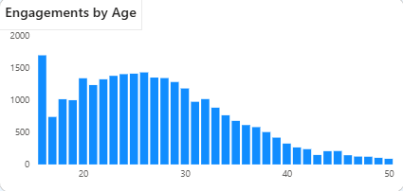
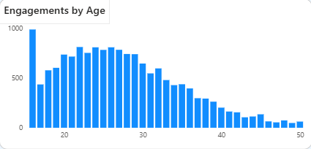
Audience Insights – Facebook & Instagram
Facebook
Instagram

Slide 6
Audience Insights – Facebook & Instagram
Overall Findings
Both platforms show a consistent female-dominant audience, with women contributing the majority of engagements across Meta Ads.
Core audience age range is 18–30, representing RetailNova’s strongest shopper demographic.
This segment responds best to lifestyle, fashion, and visual content — perfectly aligned with RetailNova’s product category.
Platform Variation
Facebook skews slightly older within the same bracket, with strong engagement from 18–35, including a noticeable secondary lift from 30–35.
Instagram skews younger, strongest in 18–25, driven by high Story and Reels engagement.

Slide 7
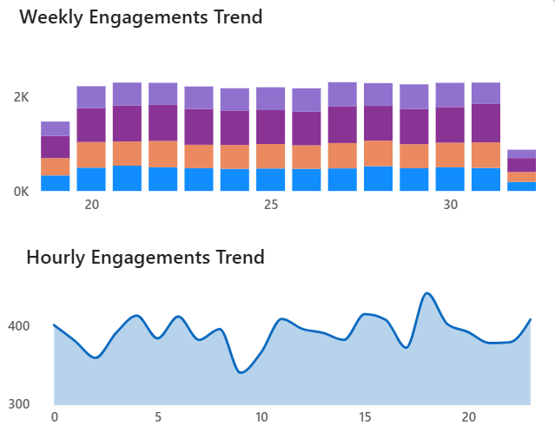
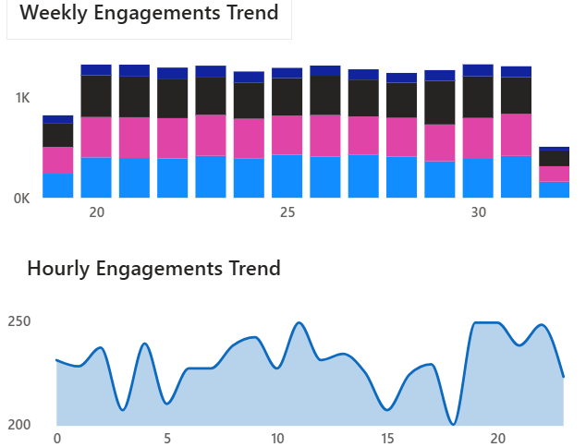
Time Trends: Facebook & Instagram
Facebook
Instagram
Weekly
Very stable week-over-week (no major drop-offs)
Hourly
Engagement peaks: 3 PM – 8 PM
Early afternoon (1–3 PM) warm-up
Mornings (8–11 AM) consistently weak
Weekly
Slightly more variation than Facebook
Still generally stable, no major dips
Hourly
Peaks: 5 PM – 10 PM
Late evening performance is stronger on Instagram than Facebook

Slide 8

AD Type Performance: Facebook & Instagram
Facebook
Instagram
Video Ads
Stories
Video Ads
Stories
CTR: 11.78% | CR: 5.56%
CTR: 11.35% | CR: 5.63%
CTR: 11.88% | CR: 5.56%
CTR: 11.23% | CR: 5.46%
Static Image
Carousel
Static Image
Carousel
CTR: 11.23% | CR: 5.23%
CTR: 11.08% | CR: 5.24%
CTR: 12.14% | CR: 4.62%
CTR: 11.69% | CR: 4.60%
Across both platforms, Video and Stories significantly outperform static formats in driving user engagement and conversion. Visual-rich, motion-based creatives clearly resonate best with RetailNova’s audience.
The performance gap is consistent across CTR, Conversion Rate, and Engagement Rate — making a strong case for reallocating budget toward dynamic ad formats.

Slide 9
Audience Comparison – Cross Platform
Facebook | Instagram
Broader Reach | Younger Audience (<25)
Balanced Gender Mix | Higher Female concertation
Strong Performance in 18-35 | Stronger evening engagement
Earlier Engagement Window | Best performance in stories
More Reliable weekly stability | Stronger short video engagement
Stronger Conversion rate | Better Mid funnel engagement
Better Global Reach

Slide 10

Strategic Recommendations
Observation | Recommendation
High CTR but low purchases | Improve landing page UX and retarget high-intent clickers
Dominant female 18 – 30 segments | Build persona-driven content & influencer collabs.
Evening engagement peak | Allocate budget 3 PM – 8 PM to maximize ROI.
India / Brazil volume; UK / Germany value | Segment campaigns by goal (awareness vs premium conversion).
Video & Stories outperform | Increase budget share for these formats.
Platform differences | Maintain distinct Facebook and Instagram playbooks.

Slide 11
Conclusion – Final Takeaways
Strong Awareness & Engagement
Funnel leakage at purchase stage
Video & Stories outperform static formats
Younger audience dominance on Instagram
Expected 20-25% ROI on optimization

Slide 12
Thank You

